Slide 1
Cosmetics Alliance Canada
Guidance for Re-Opening
In-Person Cosmetics Retail
This guidance is no substitute for the advice and direction of your government and health authorities. Always comply with local regulations.
This guidance is intended to assist in identifying and mitigating risks to promote the safety of your sales team and their customers.

Slide 2
Table of Contents
Page 3: Introduction
Page 11: 1. The Retail Space
Page 15: 2. The Beauty Advisor (and their workspace)
Page 19: 3. Customer Interactions
(product demos, make-overs)
Page 33: 4. Makeup Tools (keeping them clean)
Page 38: 5. Direct Sellers
Page 40: Training: The Need to Understand the
“What & Why” of Mitigation
Page 44: Resources & Links to Materials

Slide 3
introduction

Slide 4
What We know about covid-19
Virus spread through:
- respiratory droplets generated when you cough/sneeze
- prolonged personal contact (touching, shaking hands)
- touching something with the virus on it, then touching
mouth, nose or eyes before washing hands
Survives on surfaces from several hours to days (depending on surface type, humidity, temperature); but can be inactivated on surfaces by using disinfectants
Currently, no proven treatment or vaccine
Mortality rate double that of flu (~3.5% worldwide)

Slide 5


There are no guarantees in preventing the transmission of covid-19
Currently, there is only Risk Mitigation!
Common methods to reduce the risk of exposure:
Minimize contact with others
Social distancing (6 ft or 2 m)
Wear personal protective equipment
Wash hands frequently
Disinfect surfaces (as well as products, tools, etc.)

Slide 6

How COVID-19 easily spreads the benefit of mitigation

Slide 7
General Re-opening rules
Each jurisdiction/community different
Always follow the advice and direction of local government and health authorities
Always comply with local regulations
Also, look for guidance from sector-specific trade, industry, and professional associations

Slide 8

“In-Person” cosmetics retail
As communities begin to re-open retail …
How do we open-up “in-person” cosmetics retail as safely as possible?
How do we continue to mitigate risk?

Slide 9
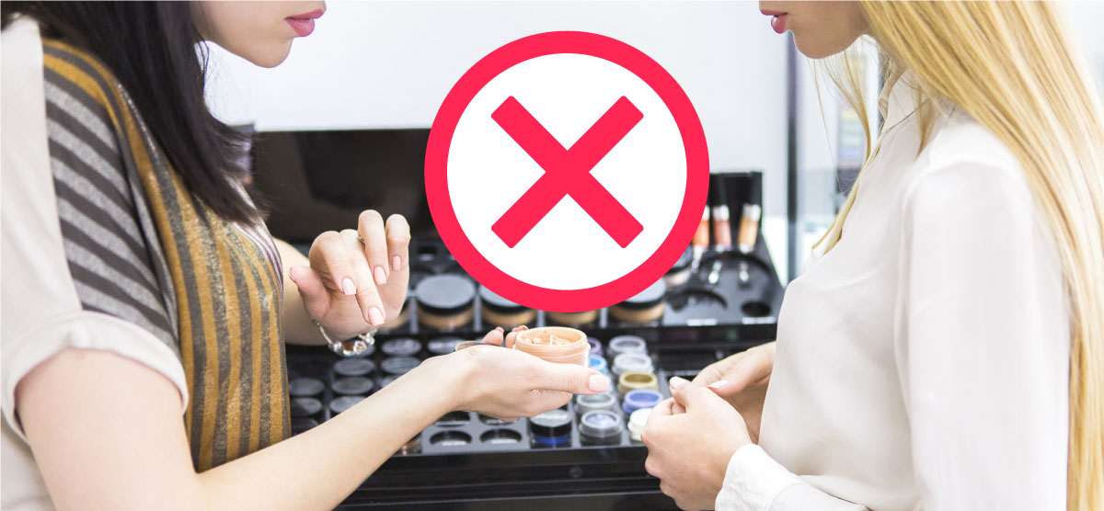
INTENT OF THIS GUIDANCE
Assist our members to Identify and Mitigate Risks to promote the safety of our:
beauty advisors/service providers, direct sellers, brand representatives, and
their customers and clients

Slide 10

Breaking Down the Challenge
What You Need to Considered
The Retail Space
The Beauty Advisor (and their workspace)
Customer Interactions (product demos, make-overs)
Makeup Tools (keeping them clean)
Direct Sellers

Slide 11
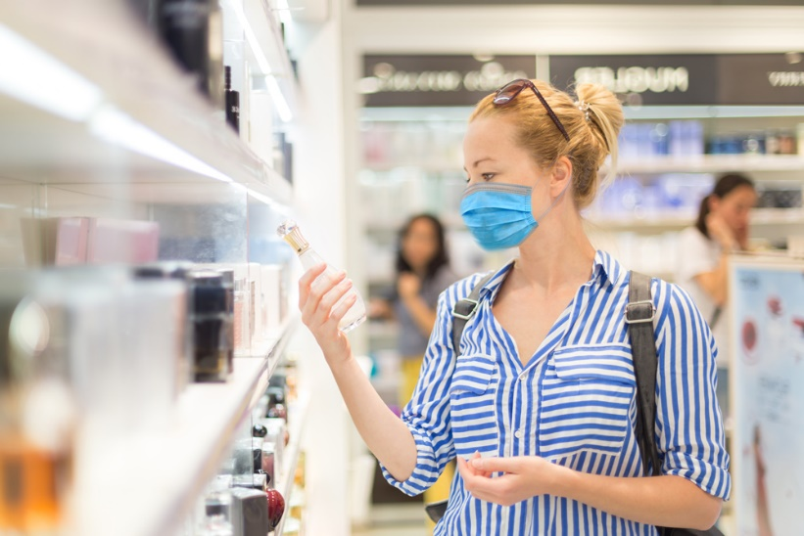

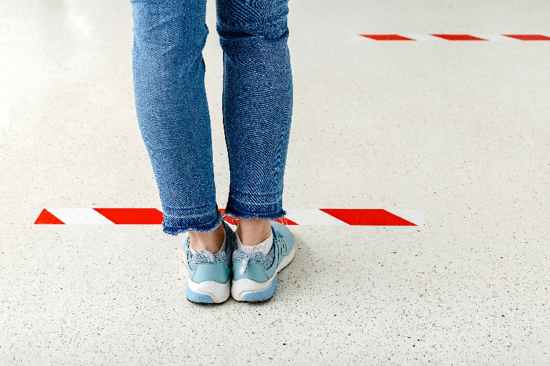
1. The retail space
As workplaces begin to reopen, it is important that good practices are in place to prevent the spread of COVID-19!

Slide 12
1. The retail space, continued
General Recommendations:
Control store access (“1 in / 1 out”, curbside pickup)
Provide hand-sanitizer at store entrance
Require the use of masks
Ensure physical distancing (signage, directional aisles, plexiglass shields, etc.)
Control access to products
Do not allow testers for self-use
Ensure frequent, scheduled cleaning and sanitization of the store (including washrooms)

Slide 13
1. The retail space, continued
Resources:
Tip Sheets:
(click to download)
Retail
General Re-opening
Detailed Retail Guidance:
Retail Council of Canada’s Road to Retail Recovery Playbook (available HERE)

Slide 14
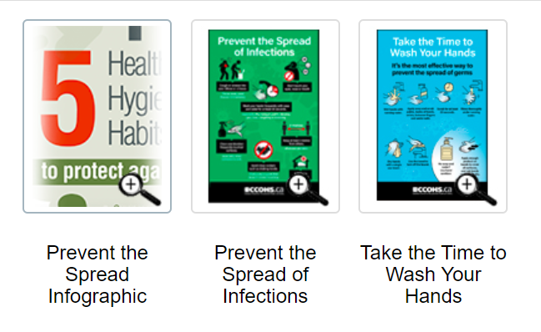
1. The retail space, continued
Resources:
Signage: (available HERE)

Slide 15
2. The BEAUTY Advisor
Recommendations to Protect the BA:
Ensure BA is willing and able to return to work
Conduct and document wellness check prior to shift
Ensure physical distancing, proper signage, and availability of hand sanitizers/hand-washing stations throughout store and at Beauty counter
Install plexiglass shields at Beauty counter
Establish and post protocols for Beauty counter/workspace set-up and customer interactions
Provide personal protective equipment (PPE) especially masks and/or face-shields
Re-assure BA with frequent, clear communications

Slide 16
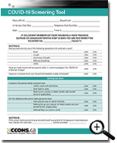
2. The Beauty advisor, continued
Resources:
Tip Sheets:
(click to download)
COVID-19 Screening Tool
Preventing Stigma
Check-lists for the BA:
(see pages 17 and 18)
Arriving at your Workplace
Setting up your Workspace

Slide 17
Check-list for the Beauty Advisor:
ARRIVING AT YOUR WORKPLACE
Locate and use the designated area for locking up personal belongings (purse, cell phone, medications, food NOT to be near workspace)
Wash and sanitize hands
Apply face mask and gloves
Clean frequently touched surfaces (purse/cell phone) with disinfectant before putting items away in locker or cupboard (tip: use hands-free mode on cell phone to avoid touching face)
Handle uniforms as little as possible (tips: wash clothes
at > 60 deg C for at least 30 minutes; long sleeves
recommended; do not reuse uniforms, smocks, aprons)
Personal Protection Equipment Kit:

Slide 18
Check-list for the Beauty Advisor:
SETTING UP YOUR WORKSPACE
Apply makeup in designated application areas only
Do not allow anyone to touch or test any products
Cover all cosmetic displays with acrylic shields or wrap
Only products stored in a controlled, secured area
(closed kit, drawer behind counter) should be used for application
Never work with products that have been left open
and exposed to the environment or unattended
Have numerous sets of product available
so you can rotate products being used
Sanitize each product set before a rotation
quarantine for a minimum of seven days
Post appropriate signage to assure customers of
the safe practices in place and promote compliance

Slide 19
3. Customer interactions
Recommendations:
Makeup, skincare, and fragrance testers should NOT be on display
ALL tester/sampling products must be stored and secured in a controlled space not accessible to the public
Establish strict protocols for product handling and testing as well as makeup application to ensure the safety of the BA and customer
Only trained BA’s should help customers test a product
Sanitize all products before and after each customer interaction
Use face charts, smudge sheets, and blotters as applicable for makeup, skincare, and fragrance product testing
Only single-use, disposable applicators are to be used for product sampling or application

Slide 20
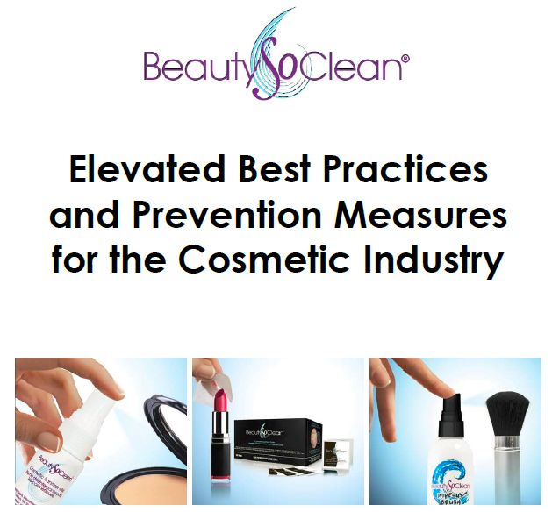
3. Customer interactions, continued
Resources:
Elevated Best Practices & Prevention Measures for the Cosmetic Industry
(click to download)
Check-lists for the BA:
(see pages 31 and 32)
Before & After Each Application
Protecting Your Customer

Slide 21
3. Customer interactions, continued
Excerpts from BeautySoClean’s®
Elevated Best Practices & Prevention
Measures for the Cosmetic Industry:
Makeup Application Protocol for the Beauty Advisor
Steps to Take Before Starting an Application
How to Handle Makeup Products and Tools
When Applying Makeup
Alternative to Applying Makeup on the Face

Slide 22
A. Steps to Take Before Starting an Application
Ask your customer for a health check.
Have them complete the consumer agreement (including contact tracing info).
Don’t share pens (if customer needs to use your pen, disinfect before and after use).
No personal belongings on counter (ask customer to put their phone away and do not allow purses or handbags on your workspace counter).
Have your customer place their personal belongings on the floor in front of them by their feet.
Notes:
Darren – help keep things flowing, interject, etc.

Slide 23
A. Steps to Take Before Starting an Application
Ask your customer if they have ever experienced a reaction to makeup/skincare? If so, what kind?
Ask if they have allergies of any kind (i.e. shellfish, peanuts). Keep in mind that some people may also have reactions to fragrance.
Ask if your customer is wearing contact lenses. Contact-wearers are much more prone to eye irritation; if you plan on using any products with a strong scent, your customer should keep their eyes closed while you’re working to prevent excessive tearing.
If your customer has irritated or broken skin, do not apply any product. Do not treat a client if they have open sores, pink eye, or a fever. If a product irritates your customer’s skin, remove it immediately and discontinue use.

Slide 24
B. How to Handle Makeup Products and Tools
ALL sampling products must be stored and secured in a controlled space not accessible to the public.
Each product must be sanitized before and after each application.
Only single-use, disposable applicators are to be used for product sampling or application (suggested disposable applicators on pages 9 & 10 of the Elevated Best Practices & Prevention Measures for the Cosmetic Industry).
One fully cleaned cosmetic brush set is to be used per customer.
If sampling with a face chart, all products must be sanitized before and after each use.

Slide 25
B. How to Handle Makeup Products and Tools
Rotate each set of testers every seven days. When opening any new product, immediately discard the applicators that come with the product.
- Replace testers being used in the controlled
storage area at store level regularly.
- Prepare personal makeup kits for talent on air.
- Organize kits of new products for bridal parties
ahead of time.
Protocol should include specific instructions for: pencils, powder-based products, loose powders, liquid products, mascara, cream compounds, tubes, lipsticks, sponge and brush tips (specific instructions on pages 15 & 16 of the Elevated Best Practices & Prevention Measures for the Cosmetic Industry).

Slide 26
C. When Applying Makeup
Only use clean, sanitized tools to transfer product.
Use a new, sanitized, disposable applicator to remove product from its container.
Always wear gloves. Never dip your fingers directly into the packaged product to remove it. Never double-dip by placing applicators or product back into a product container. Never use your hands to apply any cosmetics.
Once product has touched the skin, use a new, sanitized, disposable applicator to gather more from the container.
Only use disposable applicators, and cosmetic brushes that have been soaked/washed/dried/sanitized.

Slide 27
C. When Applying Makeup
Only use a new set of clean brushes or sanitized disposable applicators to touch your customer’s skin. Place all used brushes in a sealable bag or closed dirty brush container and throw out all used disposable applicators. Never leave used brushes or applicators on your set up area.
When working with makeup brushes, tap or shake off excess product – never blow it off.
Dispense product in containers with pumps or droppers directly onto your applicator or palette without touching any surfaces. Do not let the dispenser touch the palette.
Use a spatula or palette
- Complete any mixing required on the spatula or palette to prevent any foreign substances from touching the product.
- When moistening or activating product on the palette, always use sterile water from a sealed bottle.

Slide 28
D. Alternative to Testing Cosmetics on Face
Use a custom skin tone face chart, such as that offered by BeautySoClean® or other reputable suppliers.
Found on pages 19 – 36 of the Elevated Best Practices & Prevention Measures for the Cosmetic Industry

Slide 29
Customizable Face-Charts Available from BeautySoClean®

Slide 30
Check-list for the Beauty Advisor:
BEFORE & AFTER EACH CUSTOMER APPLICATION
Remove and dispose gloves that were used for a previous customer
Wash your hands. If a sink is not available, use a hand wipe to thoroughly wipe hands
Apply hand sanitizer
Apply fresh gloves

Slide 31

Check-list for the Beauty Advisor:
SAFEGUARDING YOUR CUSTOMER
Offer your client gloves if they are not already wearing any PPE; have disposable sealable bags available to store their face mask; do not allow your customer to touch their face at any time
Cover your client with a disposable makeup cape; keep your customers pristine by tucking a clean tissue into their collar prior to an application
Read all directions and warnings on packaging and follow them carefully
Place new disposable paper towels on your work set up area and replace with each customer
Choose the products you will be using from your controlled storage area
In front of your customer sanitize all cosmetic products that you have selected to apply after sanitizing all products
Allow 15 minutes for disinfecting hard surfaces, sanitizing cosmetics, cleanup, and preparation for your next customer.

Slide 32
4. Makeup tools, continued
Recommendations:
Establish strict protocols for the handling, cleaning and disposing of makeup tools to ensure the tools do NOT become a means for spreading COVID-19
Tools must be stored and secured in a controlled space not accessible to the public
Use single-use, disposable
tools for product sampling
and application wherever possible
Sanitize non-disposable tools
(e.g. brushes) before and after
each use

Slide 33

4. Makeup tools, continued
Resources:
Elevated Best Practices & Prevention Measures for the Cosmetic Industry
(click to download)
Guidelines for Tools
(see pages 35 - 37)
Notes:
Pictures – break into 2 slides

Slide 34
GUIDELINES FOR TOOLS
Use disposable applicators and keep in a closed container.
Never leave applicators in an open and exposed environment.
Do not double dip or use disposable applicators on more than one product.
Use bottled water when a sink is not available. If you have a sink available, disinfect the sink before and after each use.
Makeup brush sets can be used only once per client.
Designate brushes for each person or use disposable applicators.
Soak/Wash/Dry/Sanitize each set of brushes used during a shift.

Slide 35
GUIDELINES FOR OTHER TOOLS
Only use stainless steel pencil sharpeners, eyelash curlers and palettes. These tools can be cleaned with a disinfecting solution in between each client. Metal tools can be disinfected with a wipe.
Pencil sharpeners and eyelash curlers need to be sanitized by soaking for one minute in 70% IPA alcohol in a stainless steel or glass container.
Eyelash curler bands need to be replaced between each customer and disposed in the safe disposal container.
Before using your sharpener in front of your client spray your sharpener with sanitizer and blot it with a clean tissue.
Always keep a selection of disposable applicators in
a closed container, and remove the pieces required
once you have determined your application process
requirements.

Slide 36
GUIDELINES FOR OTHER TOOLS
Applicators can be used for multiple purposes if working with a metal palette. Never use one applicator to transfer product from various items for one makeup application.
Always sanitize products in front of your client before using disposable applicators, when working with face charts, or when testing product on a customer’s skin.
Always dispose of single-use applicators in a safe
disposal container.
Step 1: Clean your workspace with a disinfectant wipe.
Step 2: Place fresh disposable paper towel on your workspace.
Step 3: Choose your applicator and place on clean paper towel.
Step 4: Choose your product and place on clean paper towel.
Step 5: Sanitize your products before and after working with each
applicator. Makeup is a porous surface and when open and
exposed to the environment cross contamination can occur.

Slide 37
5. Direct sellers
Recommendations:
Direct Sellers must follow the local Public Health rules for interaction when meeting a client or customer in-person
Direct Sellers should follow the same “in-store” rules and guidance outlined above for product demonstrations and make-overs during an in-home consultation
Direct Sellers should follow the same rules and guidance for safeguarding tools

Slide 38
Additional Check-list for the Direct Seller:
IN-HOME SALES EVENTS
For a Direct Seller (DS) customer home visit or event, the DS needs to ensure the customer’s home or venue is safe and meets local Public Health requirements (i.e. has anyone in household had COVID-19, have they been social distancing, are there any other risk factors present)
The DS should keep a list of where they have been and who they have interacted with for Public Health tracing purposes; if an event involves more that the home-owner, all attendees should sign an appropriate agreement like that required for in-store customers (including info for contact tracing); avoid sharing pens, otherwise sanitize
The DS should use appropriate PPE and ensure PPE is
available for attendees, especially facemasks
The DS must comply with local rules for mitigation
including limitations on the number of individuals that
can gather, and their relationship
Venues should be cleaned and sanitized before an
event, washrooms kept cleaned, and hand-sanitizers
made available

Slide 39

Training: The Need to Understand
The “what & Why” of mitigation
It’s important to understand
what to do (i.e. the check-list),
BUT
it’s equally important
to understand
why you are doing it!

Slide 40

Training: The Need to Understand
The “what & Why” of mitigation
She gets credit for wearing a mask,
BUT doesn’t understand why.
And in not understanding,
the benefit can be lost.
Training your teams to understand
both the “What & Why”
will ensure success in re-opening!

Slide 41
training
Do you or your staff require training?
Contact:
Nancy Crossley
President, Professional Artists (Canada) Inc.
BeautySoClean®
ncrossley@proartistsint.com
Diane Kozak
Cosmetics Alliance
Beauty Specialist Certification Program
dkozak@cosmeticsalliance.ca
905-890-5161 ext. 223

Slide 42


Training Your Influencers!
Beauty Specialist Certification Program
Online courses on the science and safety of personal care products
Provides Beauty Specialists with the knowledge and confidence to address consumers’ questions and concerns
Diane Kozak
dkozak@cosmeticsalliance.ca
905-890-5161 ext. 223
More info: click HERE

Slide 43
Resources
Allied Beauty Association: www.abacanada.com
  Salon Re-Opening Resources (available HERE)
Canadian Centre for Occupational Health & Safety: www.ccohs.ca
    Tip Sheets: (click to download)
    Retail General Re-opening COVID-19 Screening Tool Preventing Stigma
    Signage: (available HERE)
Retail Council of Canada: www.retailcouncil.org
  Road to Retail Recovery Playbook (available HERE)
BeautySoClean ®
  Elevated Best Practices & Prevention Measure for the Cosmetics Industry (click to download)

